Slide 1
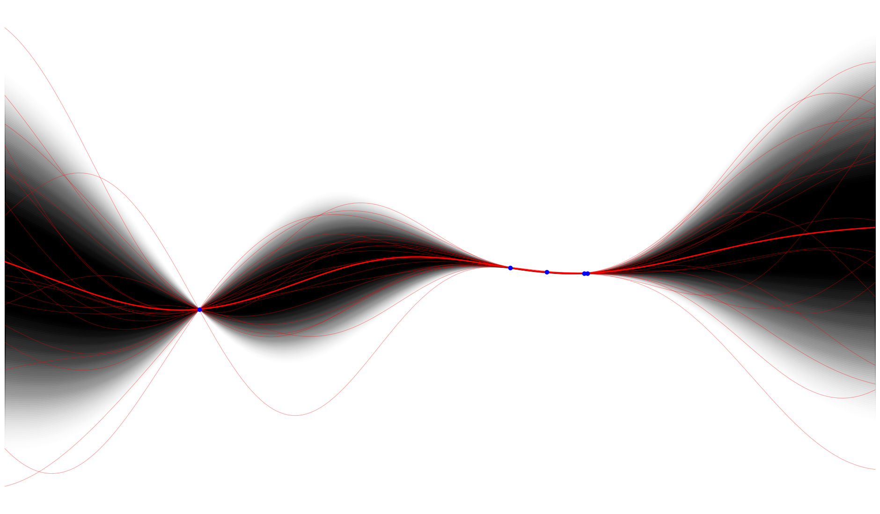
Gaussian Processes
From bell-curves to intelligent machine prediction

Slide 2
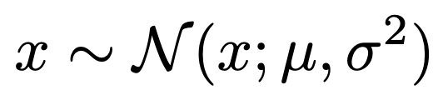
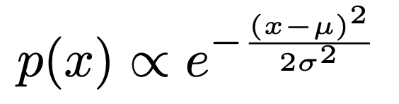

The Univariate Gaussian

Slide 3

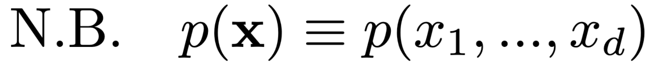
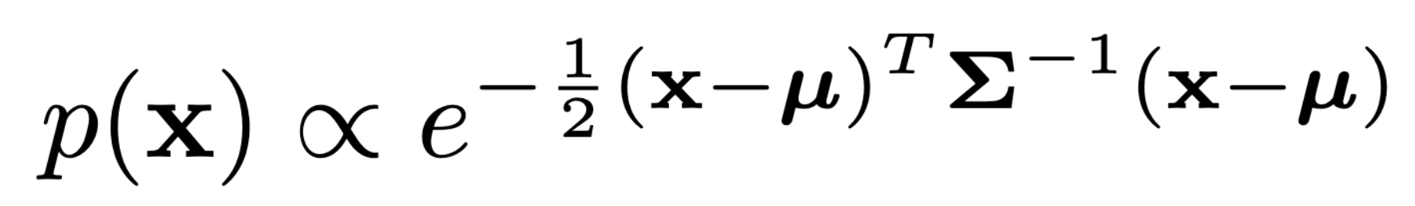
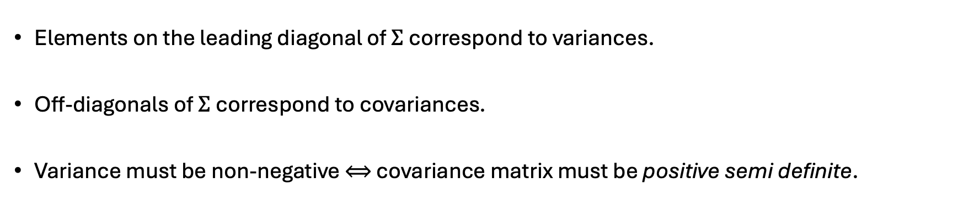
The Multivariate Gaussian (with d variates)
Elements on the leading diagonal of $Σ$ correspond to variances.
Off-diagonals of $Σ$correspond to covariances.
Variance must be non-negative $⟺$ covariance matrix must be positive semi definite.

Slide 4

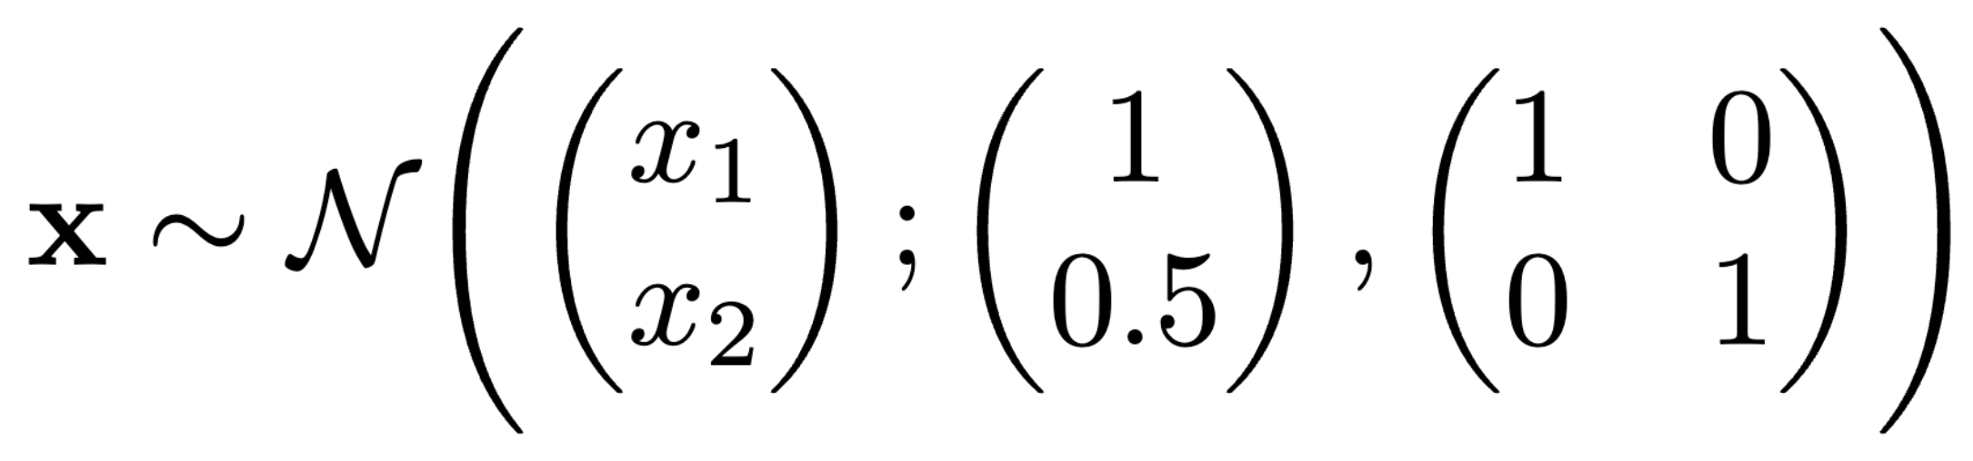

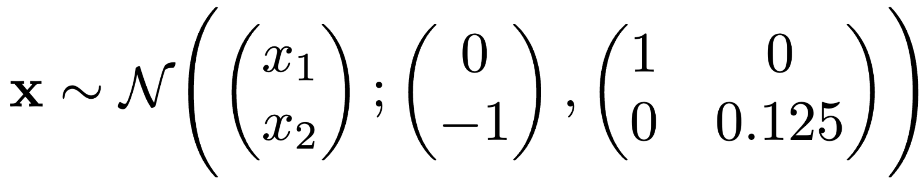

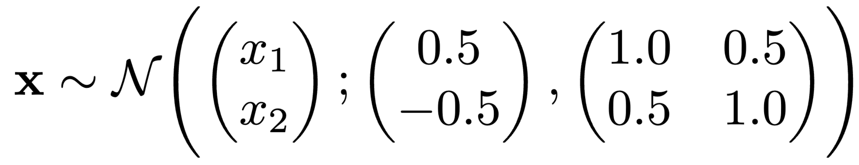
The Multivariate Gaussian (bivariate case)

Slide 5



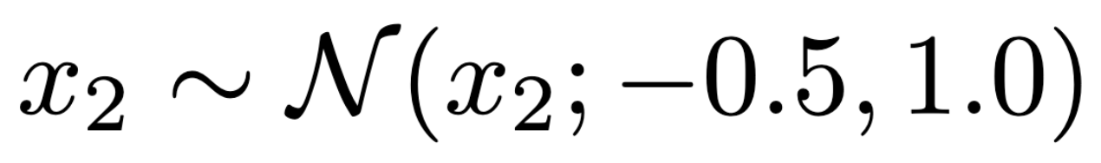
Marginalisation (bivariate case)
What is the distribution of $x_{2}$if we don’t know or care about $x_{1}$?
Marginalisation property of the Gaussian:
“If a collection of random variables is jointly Gaussian distributed, then
the marginal distribution over any subset of variables is also Gaussian.”

Slide 6
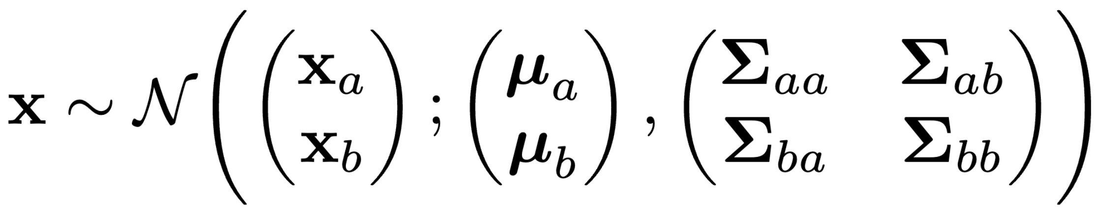
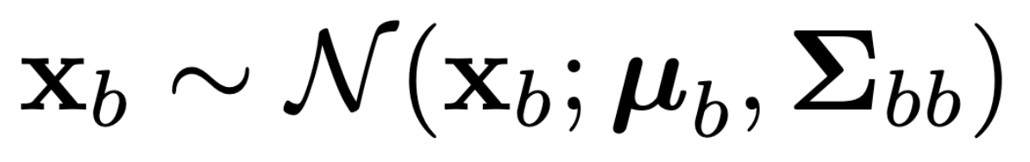
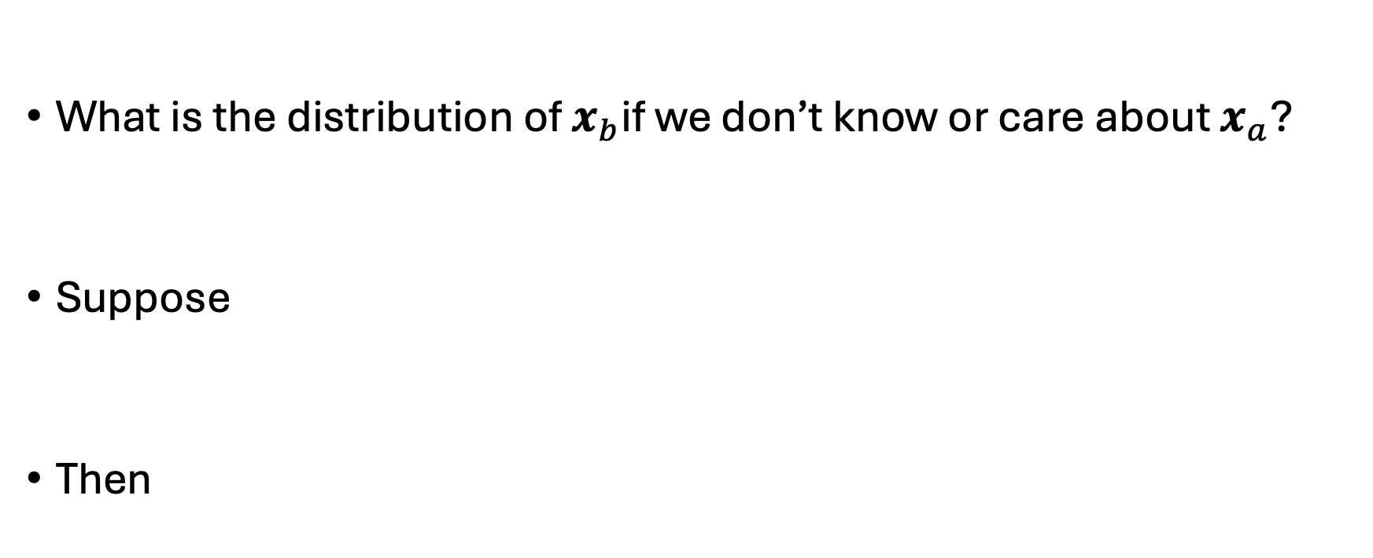
Marginalisation (multivariate case)
What is the distribution of $x_{b}$if we don’t know or care about $x_{a}$?
Suppose
Then

Slide 7
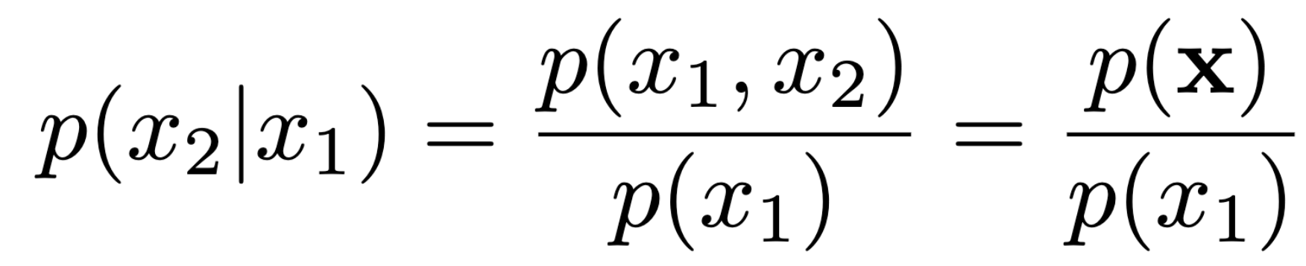
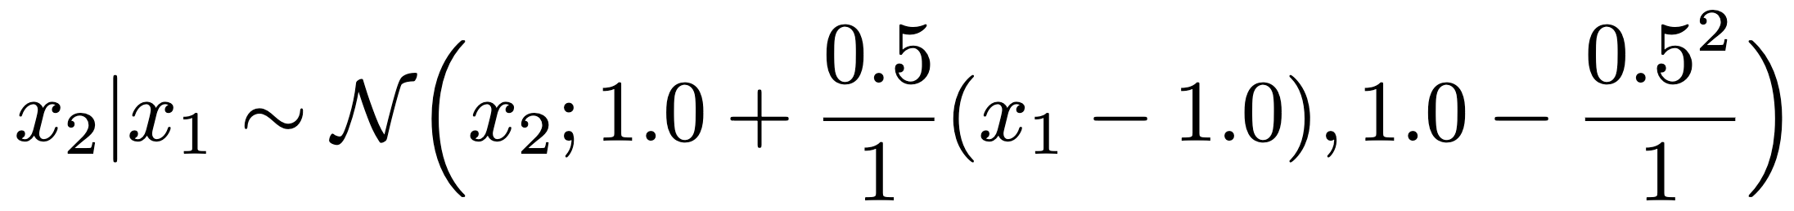
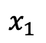
Conditioning (bivariate case)
What is the distribution of $x_{2}$if we know $x_{1}$?
$$x_{1}$$
Bayes’ rule:
The conditional distribution is also a Gaussian:

Slide 8
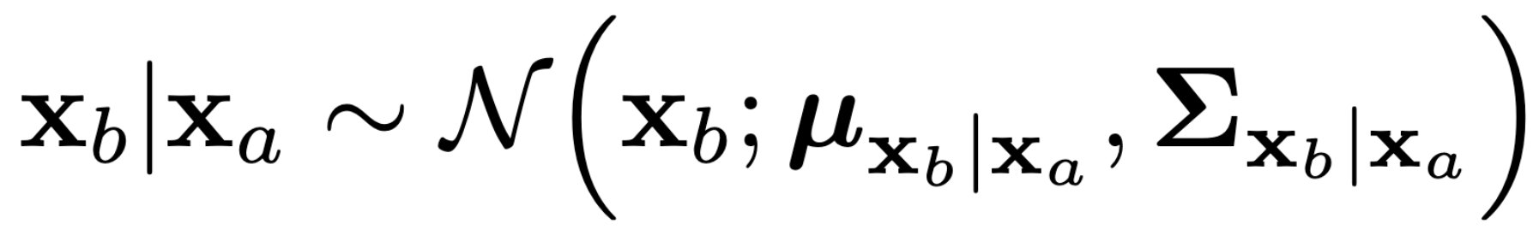
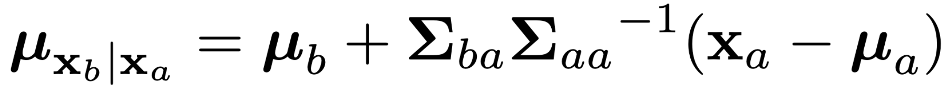
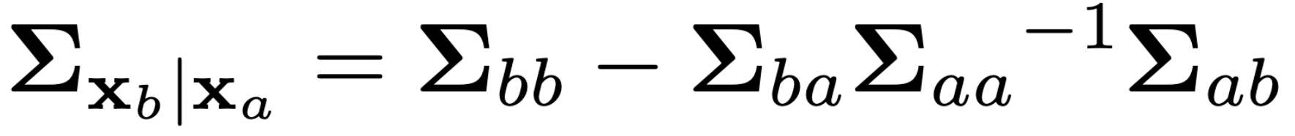
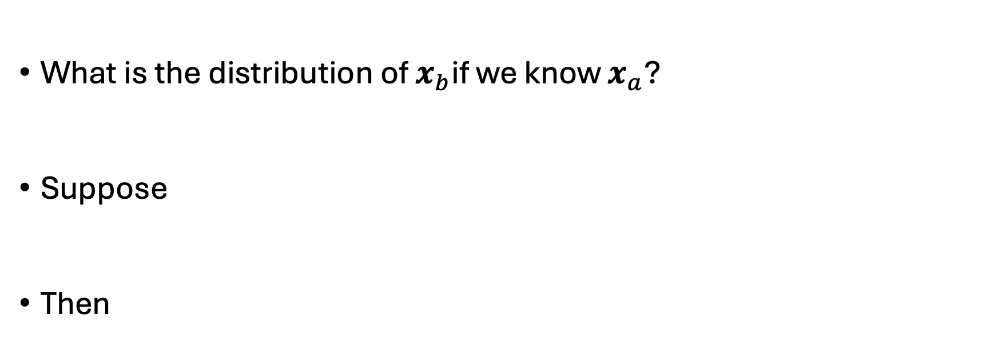
Conditioning (multivariate case)
What is the distribution of $x_{b}$if we know $x_{a}$?
Suppose
Then
where

Slide 9
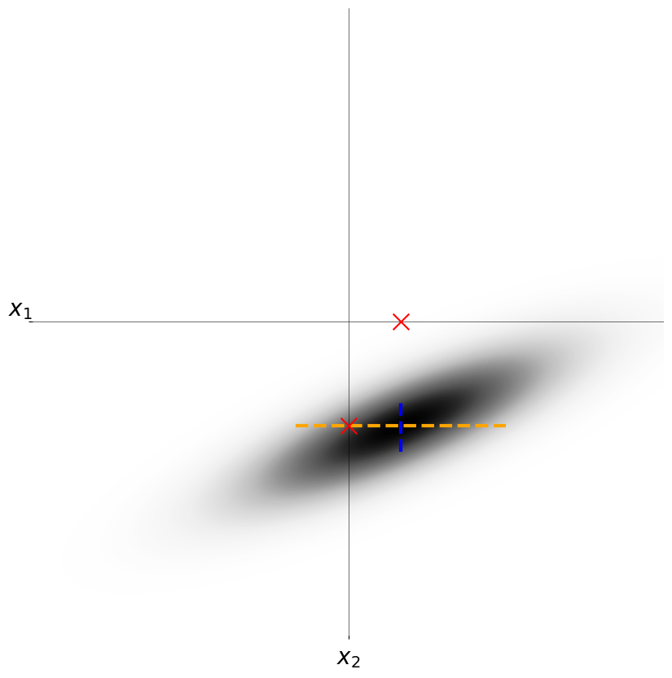
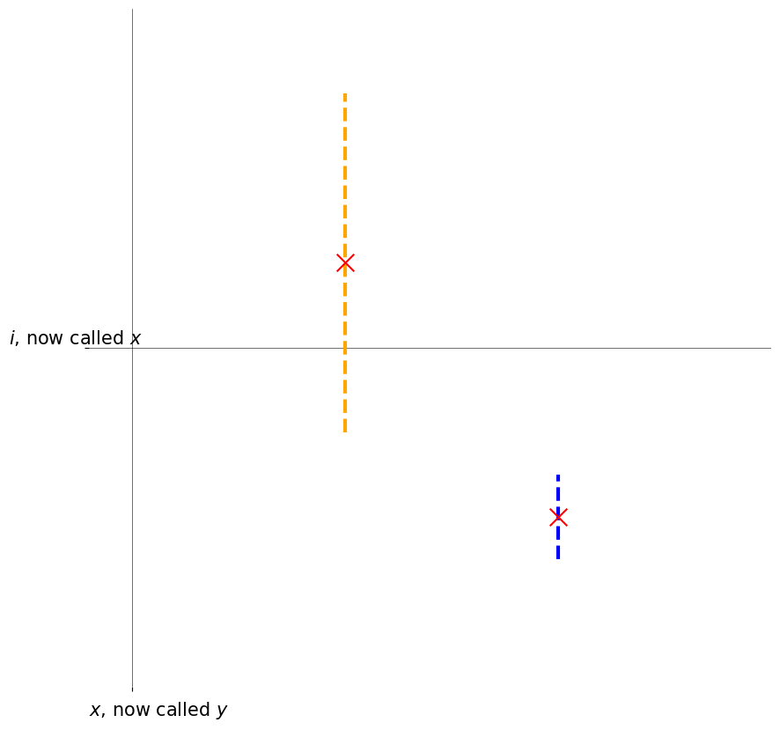
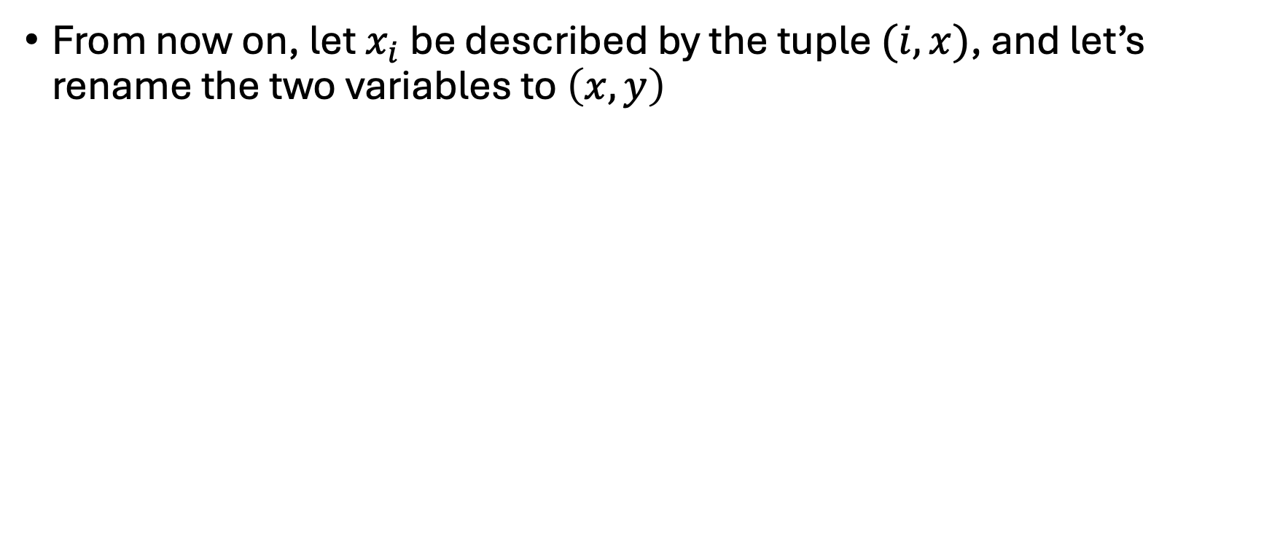
An Alternative Visualisation
From now on, let $x_{i}$ be described by the tuple $(i, x)$, and let’s rename the two variables to $\left(x, y\right)$

Slide 10
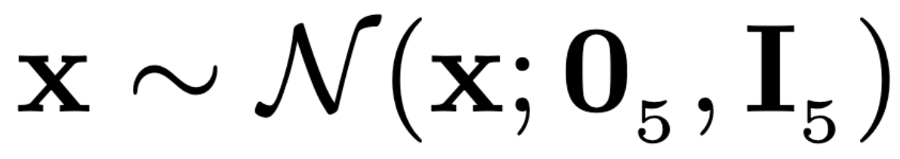
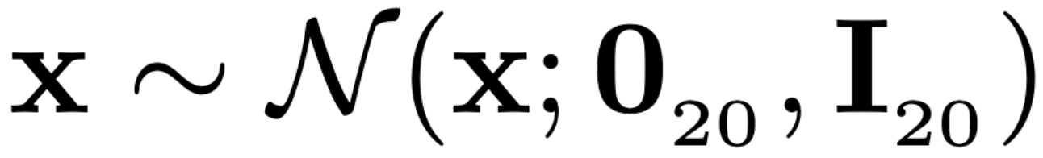
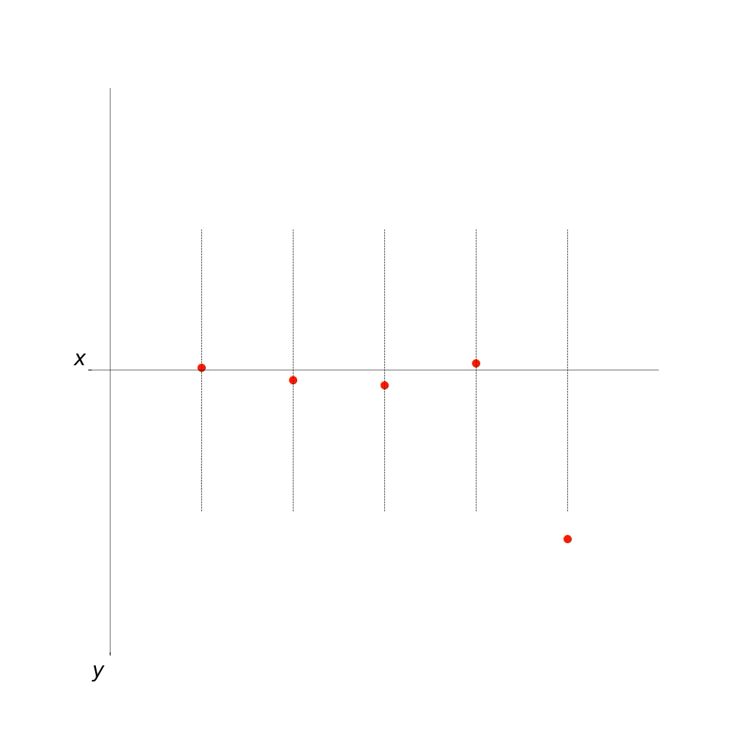
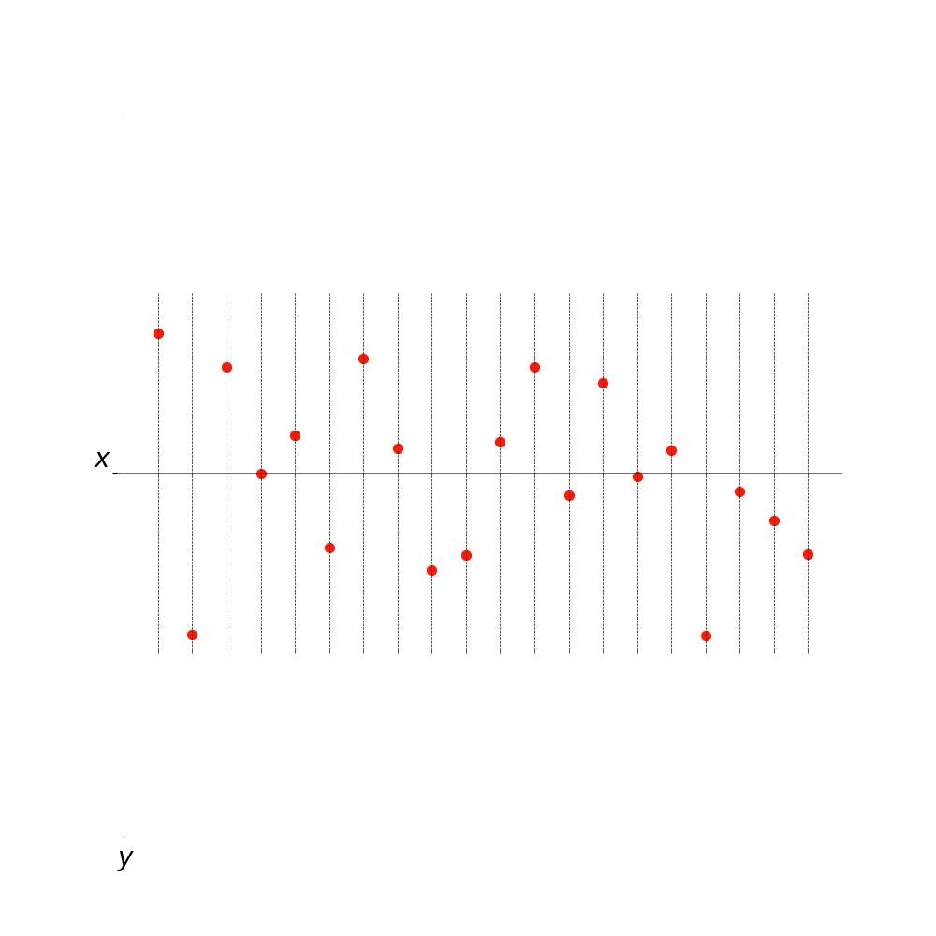
Gaussians in More than Two Dimensions

Slide 11
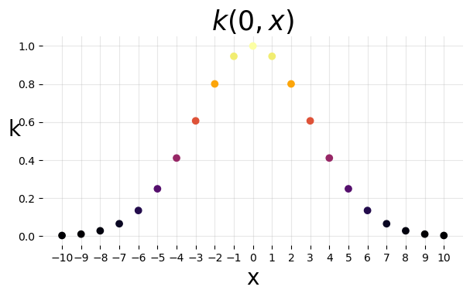
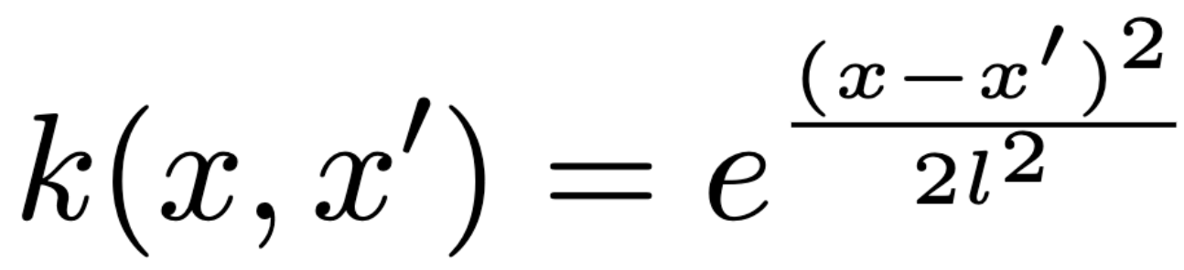
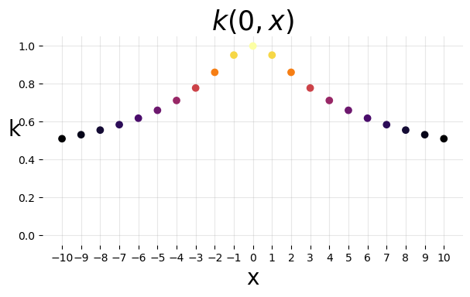
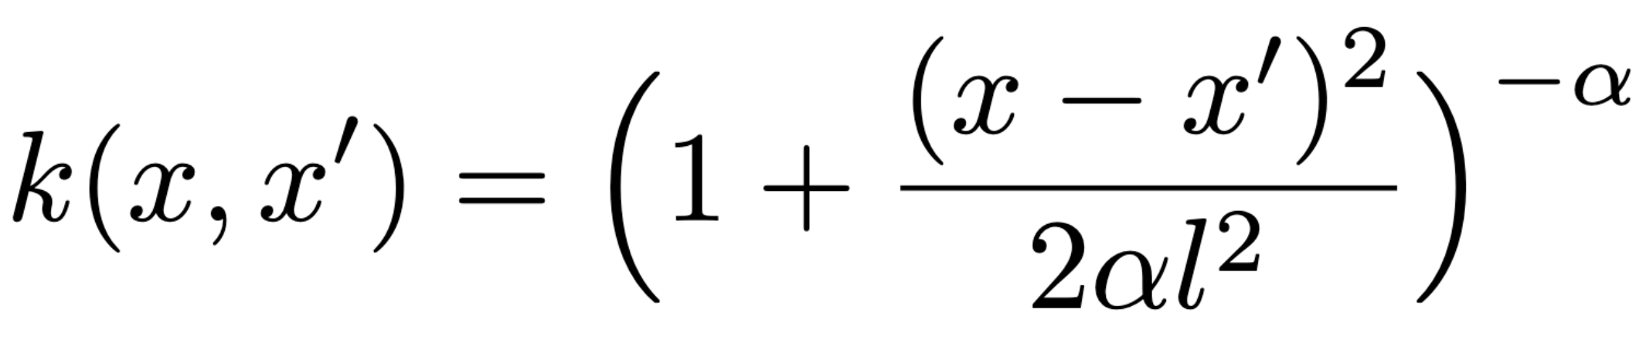
Covariance Functions
What if the covariance between pairs of variates was given by some “index-similarity” function?
As long as covariance matrices are P.S.D., the function is valid. This property is satisfied iff the function is a valid kernel function
e.g. the radial basis function:
e.g. the rational quadratic:

Slide 12

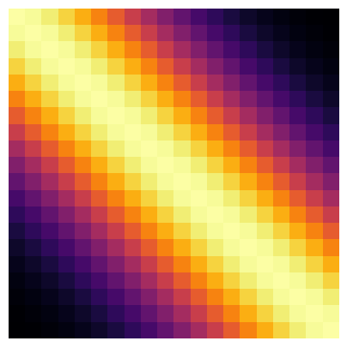

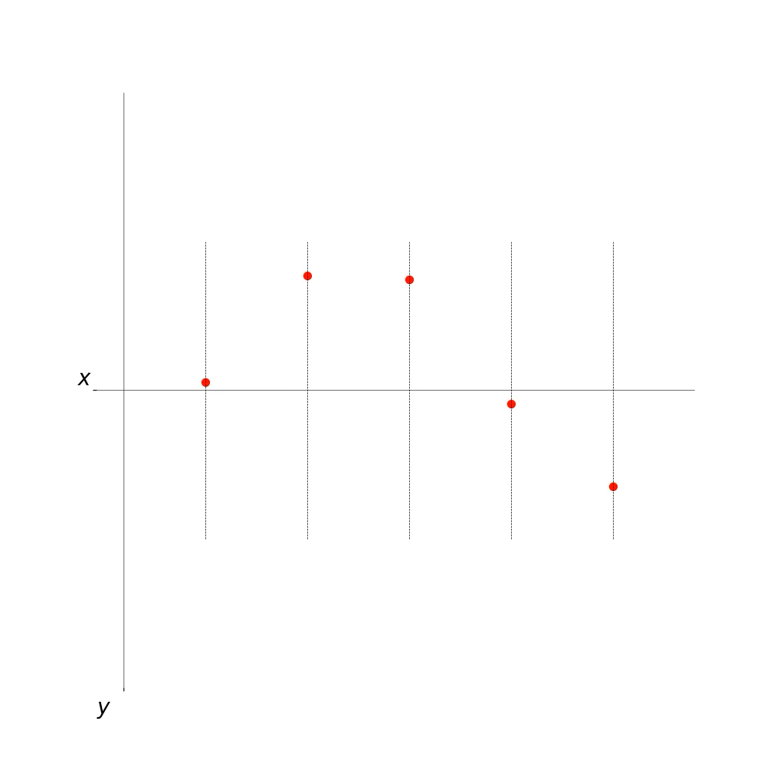

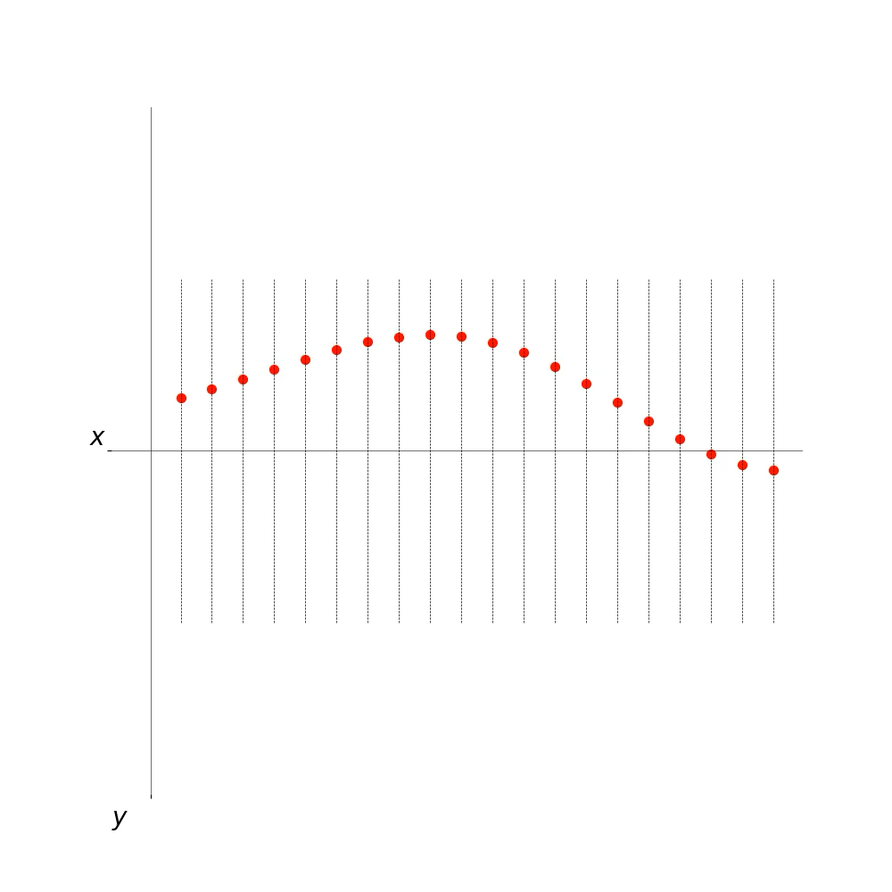
Correlated Gaussians in More than Two Dimensions

Slide 13
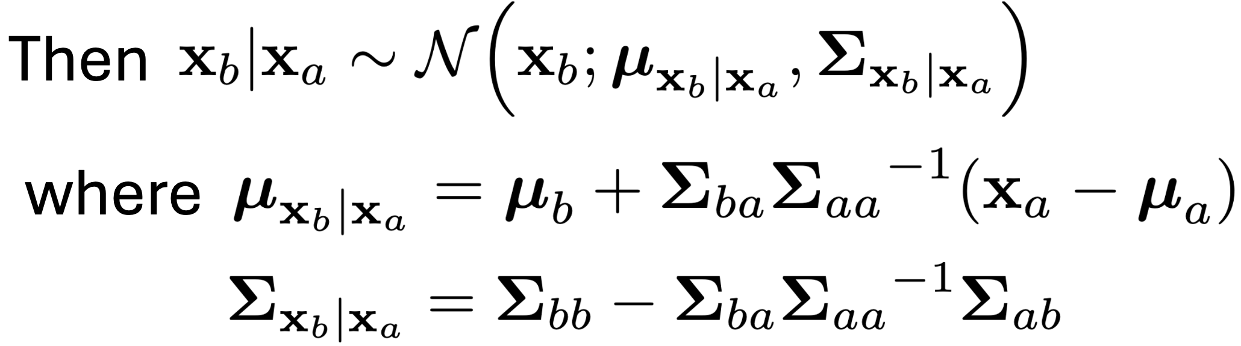
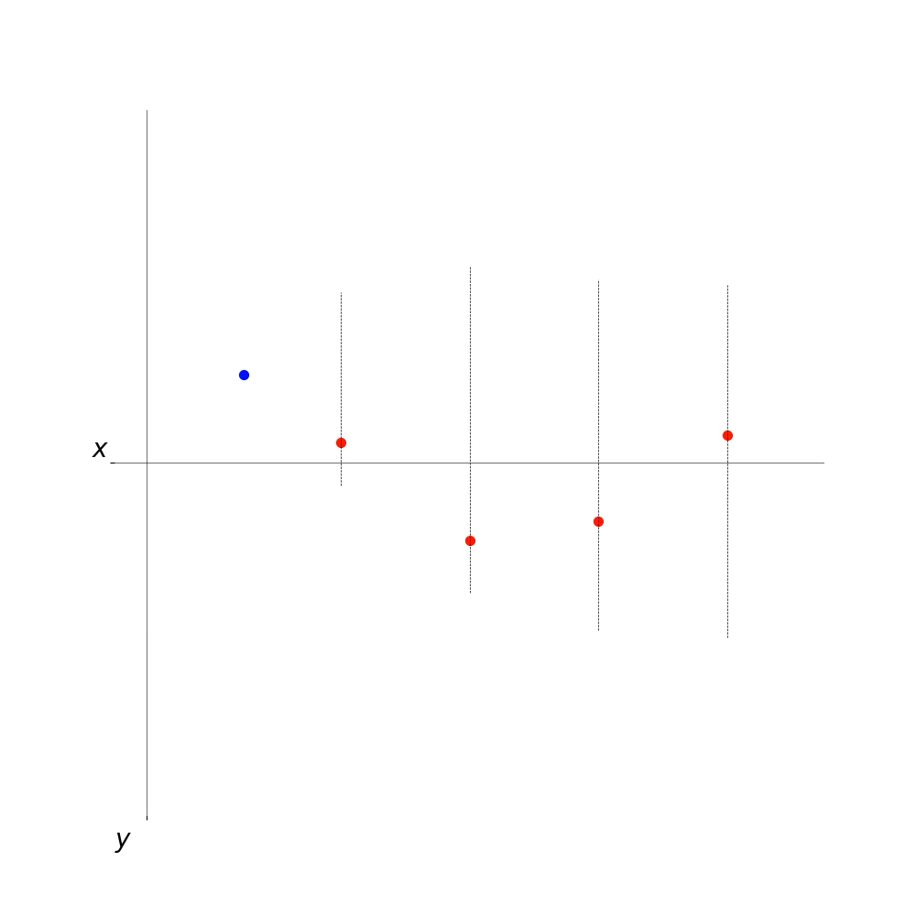
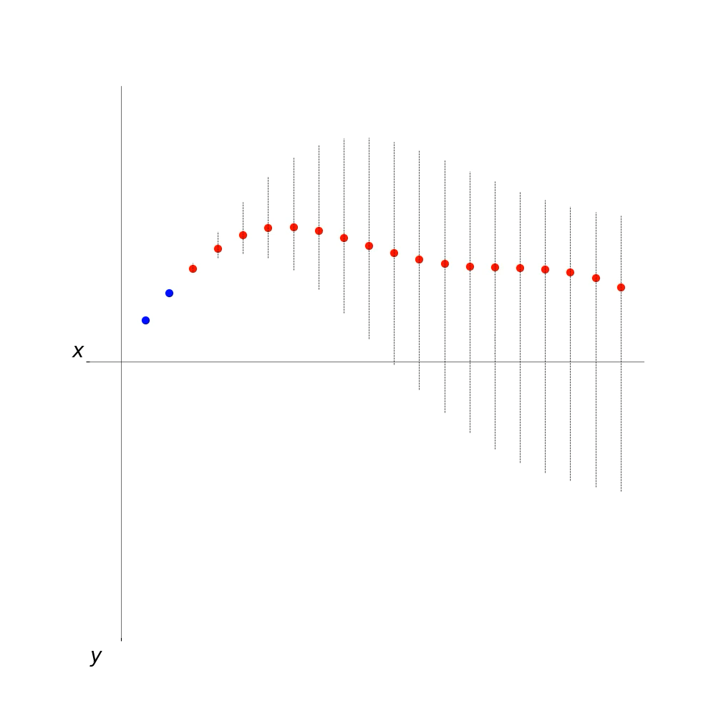

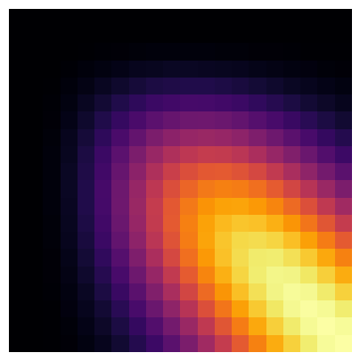
Conditioning Correlated Gaussians

Slide 14

From Variable Indices to Features
Covariance functions do not require $x$ to be integer-valued
If , we have an uncountably-infinite dimensional Gaussian distribution
Because of the marginalization property, we only need to consider the points we are interested in

Slide 15
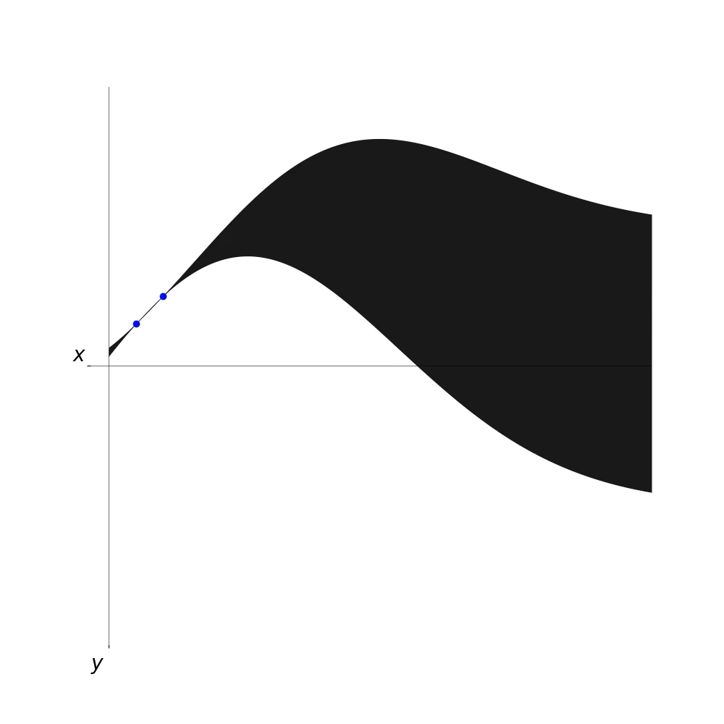
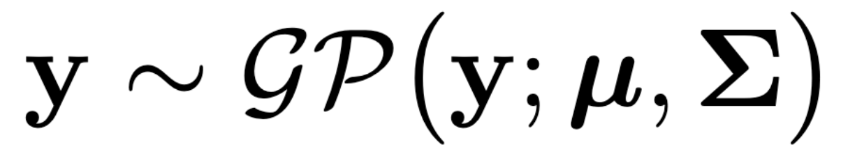
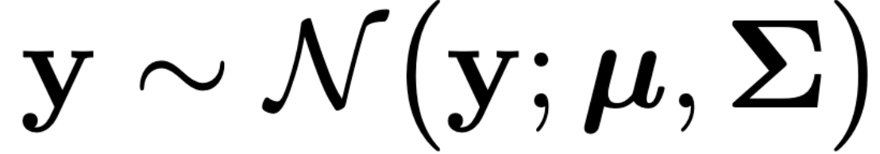


The Gaussian Process
Formal definition:
“A Gaussian process is a collection of random variables, any finite subset of which are jointly Gaussian distributed”
$$⟹$$
Multivariate Gaussian distribution
Gaussian process

Slide 16
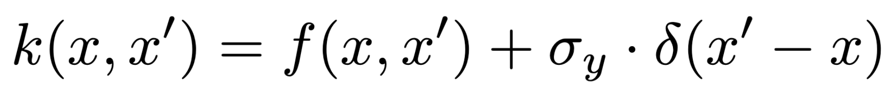
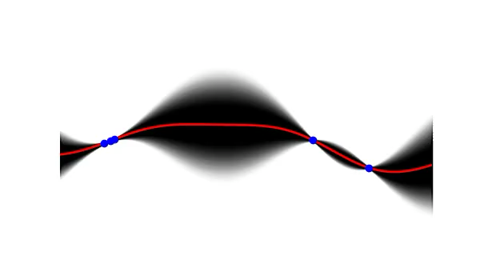
Gaussian Processes for Machine Learning
Condition on observed data
What if our data is noisy?
Solution:

Slide 17
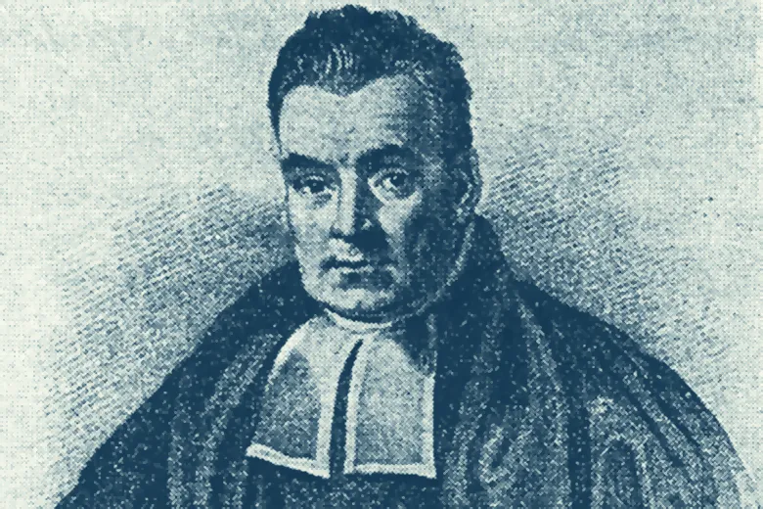

Learning in Gaussian Processes
How do we choose the “right” hyperparameters?

Slide 18
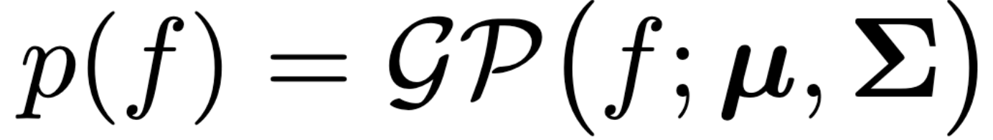
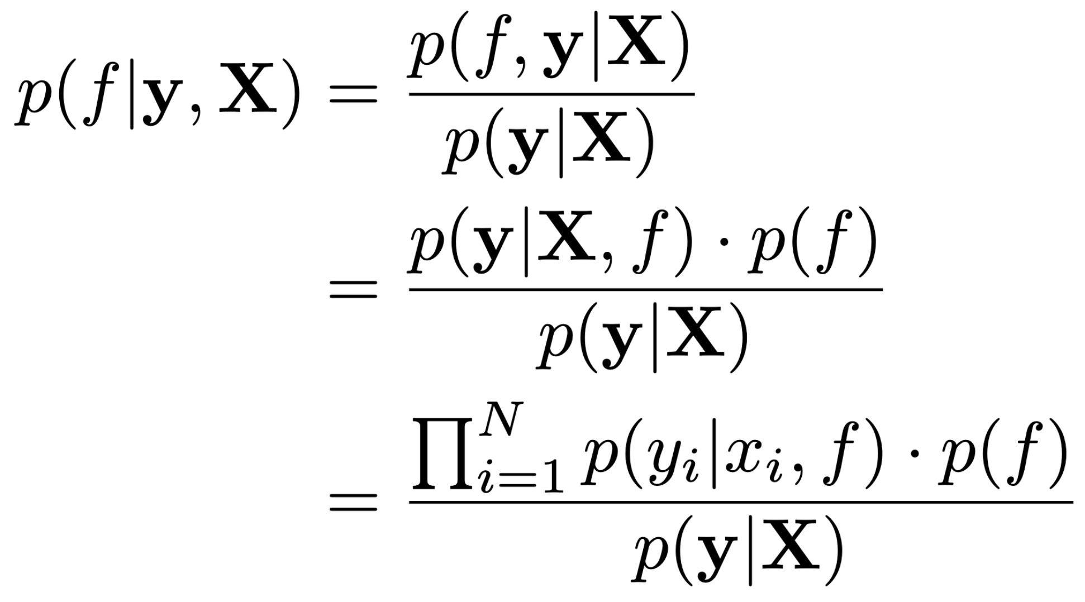
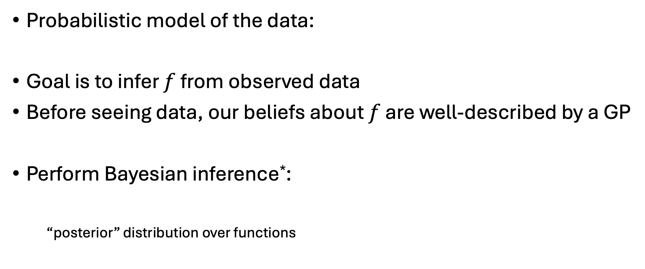
The Bayesian View of Gaussian Processes for Machine Learning
Probabilistic model of the data:
Goal is to infer $f$ from observed data
Before seeing data, our beliefs about $f$ are well-described by a GP
Perform Bayesian inference*:
“posterior” distribution over functions
“prior” distribution over functions
* “inference” $⟺$ “Bayes’ rule in the context of ML”

Slide 19
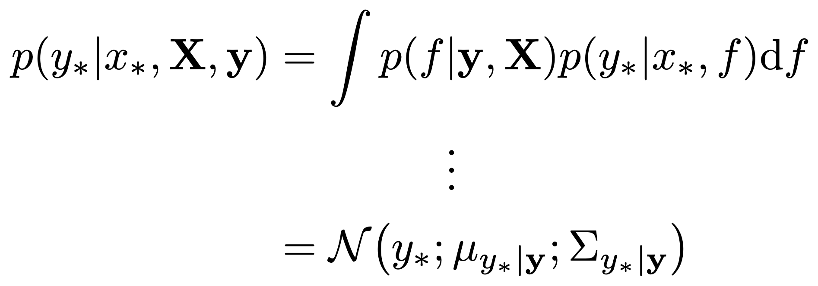
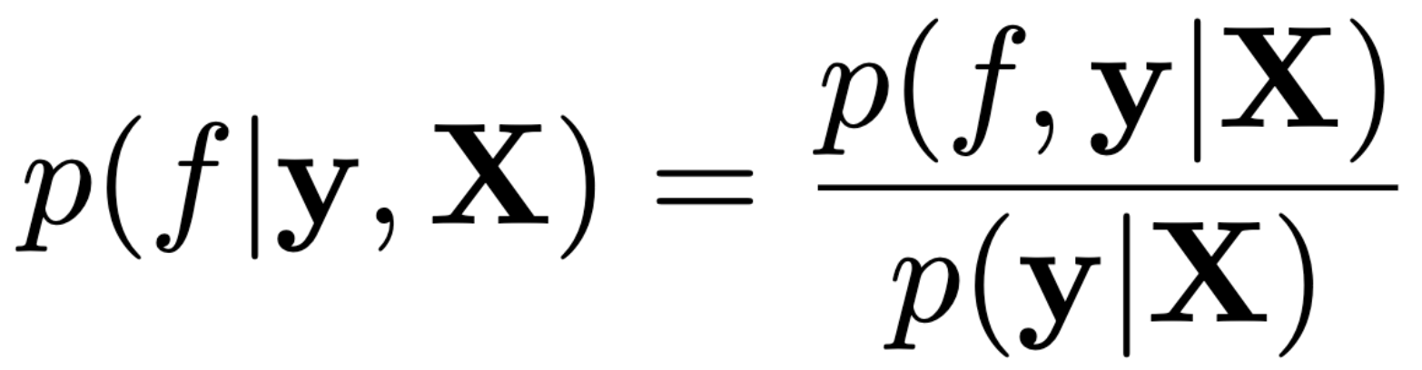
The Bayesian View of Gaussian Processes for Machine Learning (continued)
Compute predictive distribution:
What’s the point in all this?

Slide 20

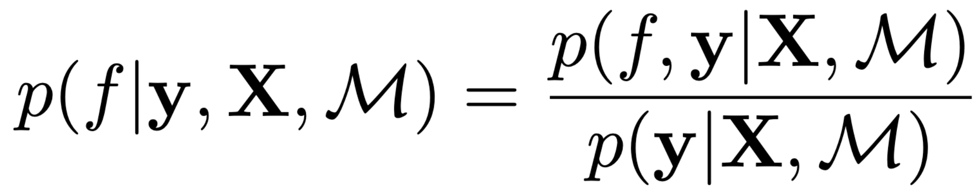


The Marginal Likelihood
Conditioning on model choice, :
then represents “how likely is our dataset given it came from a model with those hyperparameters”
For a given dataset…
Very flexible means our dataset is one example out of very many possible datasets
Very restrictive means complex datasets unlikely to have come from our model
Somewhere in the middle is just right…
Optimising the marginal likelihood w.r.t. performs automatic Occam’s razor learning!
$$⟺$$
We’ve been making this assumption, we just haven’t been explicit about it up until now

Slide 21



Learning in Gaussian Processes: examples
Learning the lengthscale:
Learning $σ_{y}$:

Slide 22

Problems
Intractability:
Computational. Inference cost is
Analytical. If noise model is non-Gaussian, the posterior is (generally) non-Gaussian and (generally) unknown. e.g. classification
Solutions:
Scaling approximations. Sparse GPs, multiple local experts, etc.
Posterior approximations. MCMC, variational inference, EP

Slide 23


Working with Gaussian Processes: GPyTorch

Slide 24
Questions?

